Slide 1
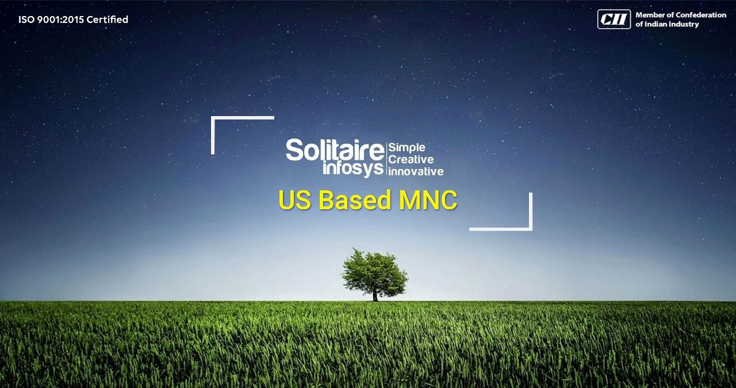

Slide 2
SIGNLEXICON
Sign Language Recognition System using Computer Vision and Deep Learning
Submitted by:
Mannatdeep Kaur Chohan
M.Tech AI & Robotics (5-year integrated)
Guru Nanak Dev University, Amritsar
Summer Internship Project
Solitaire Infosystems Pvt.Ltd.

Slide 3
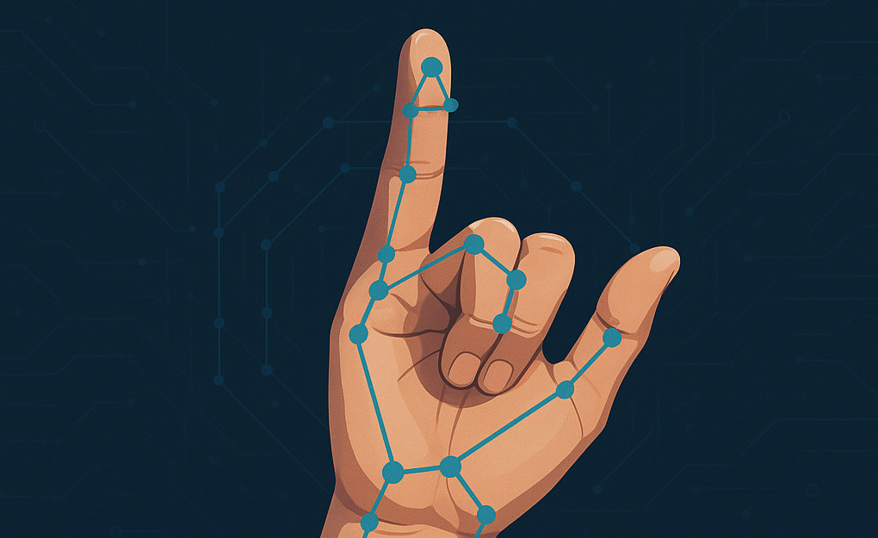
INTRODUCTION
Sign languages are languages that use the visual-manual modality to convey meaning rather than spoken words. They are expressed through manual articulation in combination with non-manual markers, and are full-fledged natural languages with their own grammar and lexicon.
Sign languages are not universal and are usually not mutually intelligible, although there are similarities among different sign languages.
Wherever communities of deaf and hard of hearing people exist, sign languages have developed as a means of communication and form the core of local Deaf cultures.
Although signing is used primarily by deaf and hard of hearing people, it is also used by hearing individuals, such as those with deaf family members including children of deaf adults.
Sign languages are distinct from body language, a type of nonverbal communication. Linguists also distinguish natural sign languages from other systems that are precursors to them or derived from them, such as constructed manual codes for spoken languages, home sign, baby sign language, and signs used with non-human primates

Slide 4
INTRODUCTION
Sign language is essential because it provides full, independent communication for Deaf and hard-of-hearing individuals, ensuring their inclusion in society. Beyond accessibility, it bridges cultural divides, aids in early language development for babies, and is a vital tool in situations where spoken words fail, such as in loud or quiet environments.
A communication gap is a breakdown in the exchange of information, where a message is either not conveyed clearly or misunderstood by the receiver. It typically stems from differing perceptions, language barriers, or emotional disconnects and frequently results in missed deadlines, inefficiencies, and workplace frustration.
A modern, non-invasive Sign Language Recognition (SLR) system uses camera-based computer vision and deep learning to instantly translate hand gestures and body movements into text or speech. It eliminates the need for expensive, restrictive data gloves by relying purely on AI to bridge communication gaps.

Slide 5
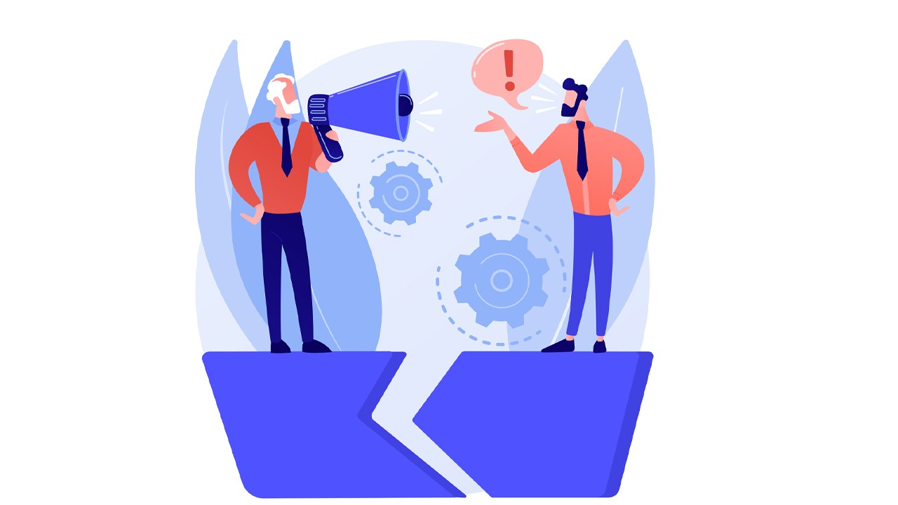
PROBLEM STATEMENT
Communication Gap: A fundamental disconnect exists in spontaneous, real-time conversations due to the low availability of sign language translators and a general lack of understanding of sign languages like ASL (American Sign Language), ISL (Indian Sign Language), or BSL by the hearing population.
Environmental & Technical Constraints: Existing models often
fail in real-world scenarios due to changing background conditions, poor or fluctuating lighting, and camera obstructions.
Lack of Spatial and Temporal Context: Many systems are confined to static alphabets. Continuous sign language requires capturing the fluidity of movement over time, necessitating complex spatial-temporal models (e.g., LSTMs or Transformers) which require large, annotated datasets that are currently scarce.

Slide 6
PROJECT OBJECTIVES
Core Model
Image & Webcam Input
Design and train a convolutional neural network (CNN) to classify ASL alphabet signs.
Support both uploaded images and live webcam prediction with real‑time confidence scores.
Desktop Application
Usability
Deliver a Tkinter desktop GUI to demonstrate predictions, screenshots and live demo workflows.
Clear label output, confidence percentage and fast feedback for interactive use.

Slide 7




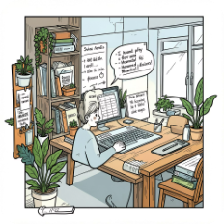
TECHNOLOGY STACK
PYTHON
Project language and glue for training, inference and GUI.
TENSORFLOW
Model training, deployment and model.save() (.keras) workflow.
OpenCV
Image preprocessing, augmentation and webcam capture pipeline.
NumPy
Numerical processing, image I/O and format conversions.
Tkinter
Desktop GUI for uploading images, viewing webcam feed and showing predictions.

Slide 8
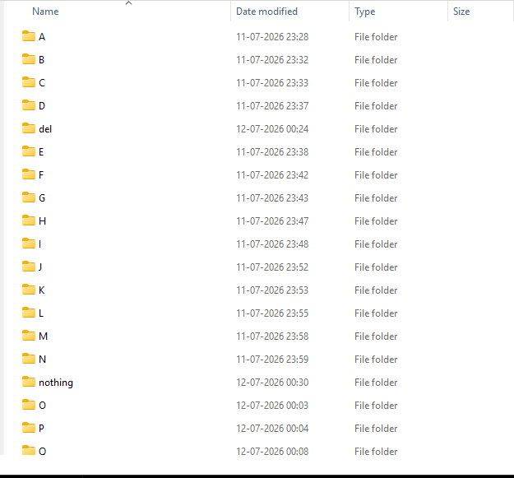
DATASET
ASL Alphabet dataset (student‑prepared partition): 29 classes (A–Z + blank/space variations)
Approx. 87,000 images total; images resized to 200×200 for training.
Data augmentation applied: rotation, shift, brightness and flip for robustness.
PARAMETER | VALUE
Dataset | ASL Alphabet
Classes | 29
Image Size | 200 X 200
Model | CNN
Framework | Tensorflow/Keras
Output Layer | Softmax

Slide 9
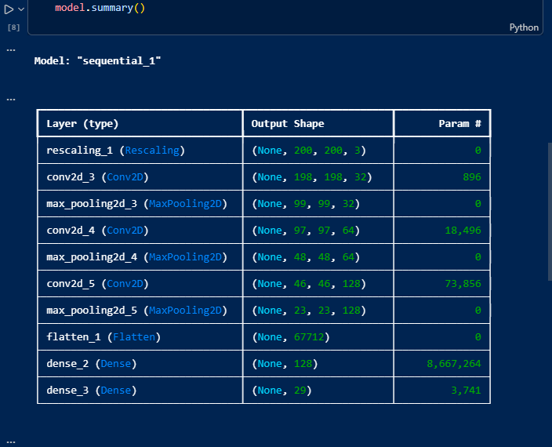
CNN MODEL
In the fields of artificial intelligence and deep learning, a Convolutional Neural Network (CNN) is a specialized type of neural network primarily used for analyzing and processing visual data (like images and videos).
CNN ARCHITECTURE SUMMARY:
Input: 200×200×3 images, normalized
Feature extractor: stacked Conv2D + BatchNorm + ReLU + MaxPool blocks.
Classifier: Dense layers with Dropout and Softmax output (29 classes)
Training: Adam optimizer, categorical, cross‑entropy, early stopping and model checkpointing.
Saved model format: model.keras (TensorFlow Keras)

Slide 10
SYSTEM WORKFLOW
Image/Webcam
CNN Feature Extraction
Image Preprocessing
The system accepts either an uploaded image or a live webcam frame.
Frames are preprocessed consistently, fed into the trained CNN, and the GUI reports the predicted ASL letter with a confidence score for user confirmation.
Classification
Prediction + Confidence
Tkinter GUI

Slide 11
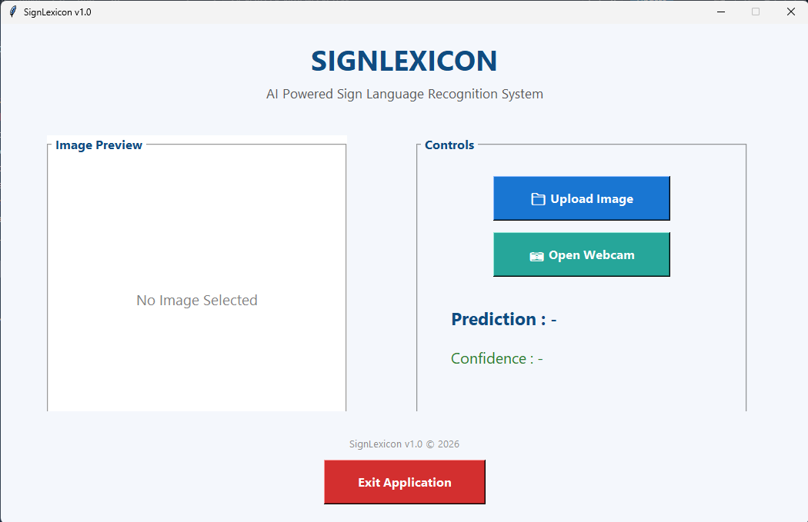
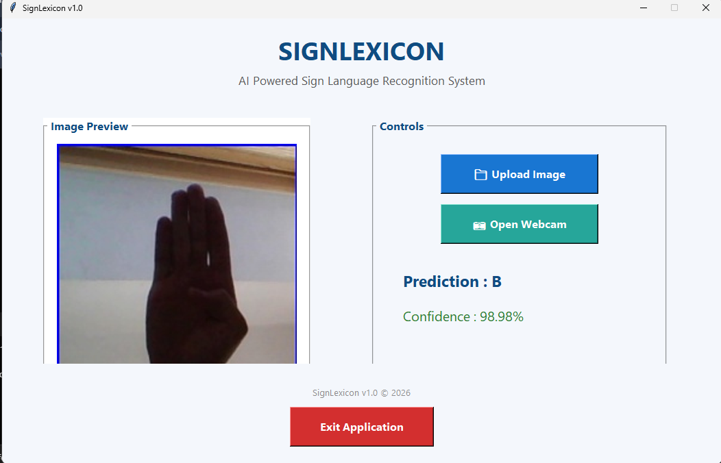
DESKTOP GUI
MAIN APPLICATION
IMAGE PREVIEW & PREDICTION

Slide 12
RESULTS
INPUT | PREDICTION | CONFIDENCE
B15.jpg | B | 98.98%
Webcam_frame_042 | B | 95%
Evaluation performed on held‑out validation splits; the model produces high confidence on clear, well‑framed hand signs. Real‑world robustness improves with more varied training data and stronger augmentation.
Predictions below the confidence threshold are displayed as "No Sign".

Slide 13
FUTURE SCOPE – VERSION 2.0
Dynamic Sign Recognition:
Advanced Perception:
Extend to temporal models (CNN + LSTM or 3D CNNs) for gestures involving movement.
Integrate MediaPipe or hand‑pose estimation to improve localisation and reduce background noise.
Sentence Generation:
Mobile App:
Convert sequential sign predictions into syntactically coherent sentences.
Deploy lightweight model (TensorFlow Lite) for smartphone assistive apps.
Speech Output:
Language Expansion:
Real‑time TTS to vocalise recognised signs for immediate communication.
Support additional sign languages such as Indian Sign Language with culturally relevant datasets.

Slide 14
Thank You!

